Slide 1
BIG GAME CENSUS ANALYTICS
DETAILED PROJECT REPORT

Slide 2
PROJECT DETAILS
Project Title | Big Game Census Analytics
Technologies | Data Science
Domain | Sports
Project Difficulties level | Advanced
Tools Used | Tableau

Slide 3
Problem statement
This Big Game Census data visualization takes a fun look at where Super Bowl 52 players come from, the related population figures, and opens up pathways (via embedded links) to additional census data points.

Slide 4

Architecture
Raw Data Collection
Importing dataset in Tableau
Creating worksheets
Real world
Insights
Creating dashboard
Reporting

Slide 5
Dataset information
All Places Census 2016 Population Estimates
All Places Census 2017 Population Estimates
Big Game Census Data :
Player Name
Player Jersey Number
Player Position
Player age
Player weight(lbs)
Years played
Player Birth place(city , town , etc)
Player Birth state
Player Birthplace (combo)
Player College
Player Team
Conference
2016 Population Estimates (except where otherwise noted)
State GEO ID
Full GEO ID
Latitude (player birthplace)

Slide 6
Longitude (player birthplace)
Number from City
Number of Records
American Fact Finder Link for more Census data points
Quick facts Link
State Data Link
Source (Population States 2017)
Birthplace, Population Data Source

Slide 7
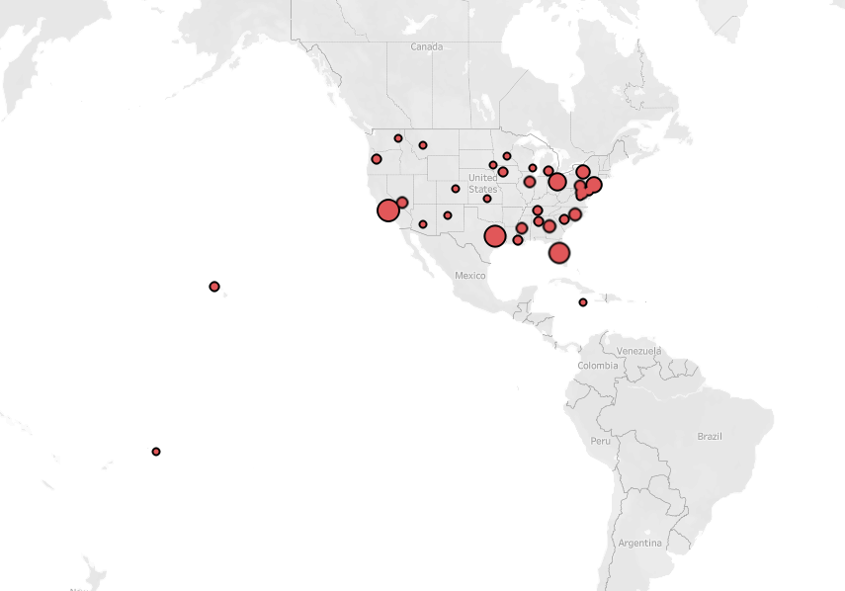
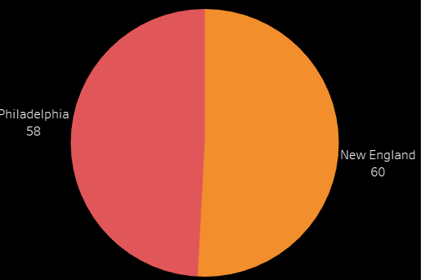
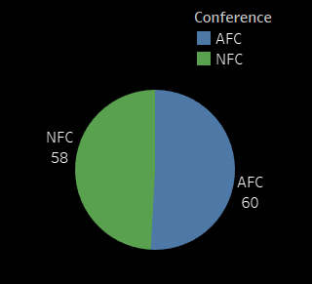
INSIGHTS
There are 58 players in Philadelphia and 60 players in New England
58 are from NFC and 60 from AFC
More number of players are from California and then from Texas

Slide 8
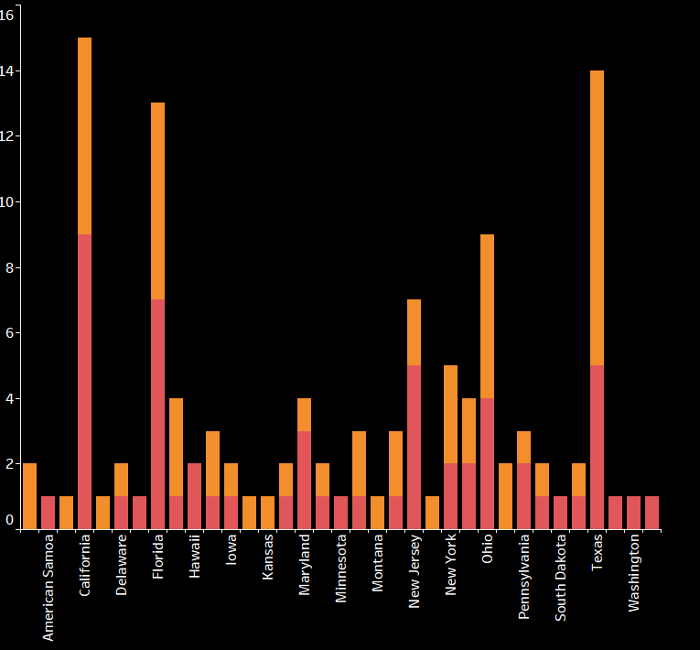

Players from each State
More Players in the team New England is from Texas
And more players in team Philadelphia are from California

Slide 9
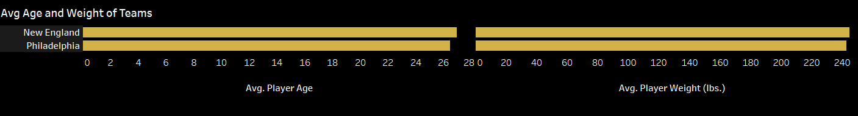
Average age of New England team is 26.967 and Philadelphia is 26.465
Average weight of New England team is 244.983 and Philadelphia is 242.741

Slide 10
Key performance indicator
Count of players by State
Players name , age , weight, team , conference and birthplace
Total players in each team
Total players in each conference
Average age and weight of Players

Slide 11
Conclusion
There are 58 players in Philadelphia and 60 players in New England
58 are from NFC and 60 from AFC
More number of players are from California and then from Texas
More Players in the team New England is from Texas
And more players in team Philadelphia are from California
Average age of New England team is 26.967 and Philadelphia is 26.465
Average weight of New England team is 244.983 and Philadelphia is 242.741
More number of players are from college Stanford(total 5)

Slide 12
THANK YOU

